Slide 1

Cleaning Crew

Slide 2
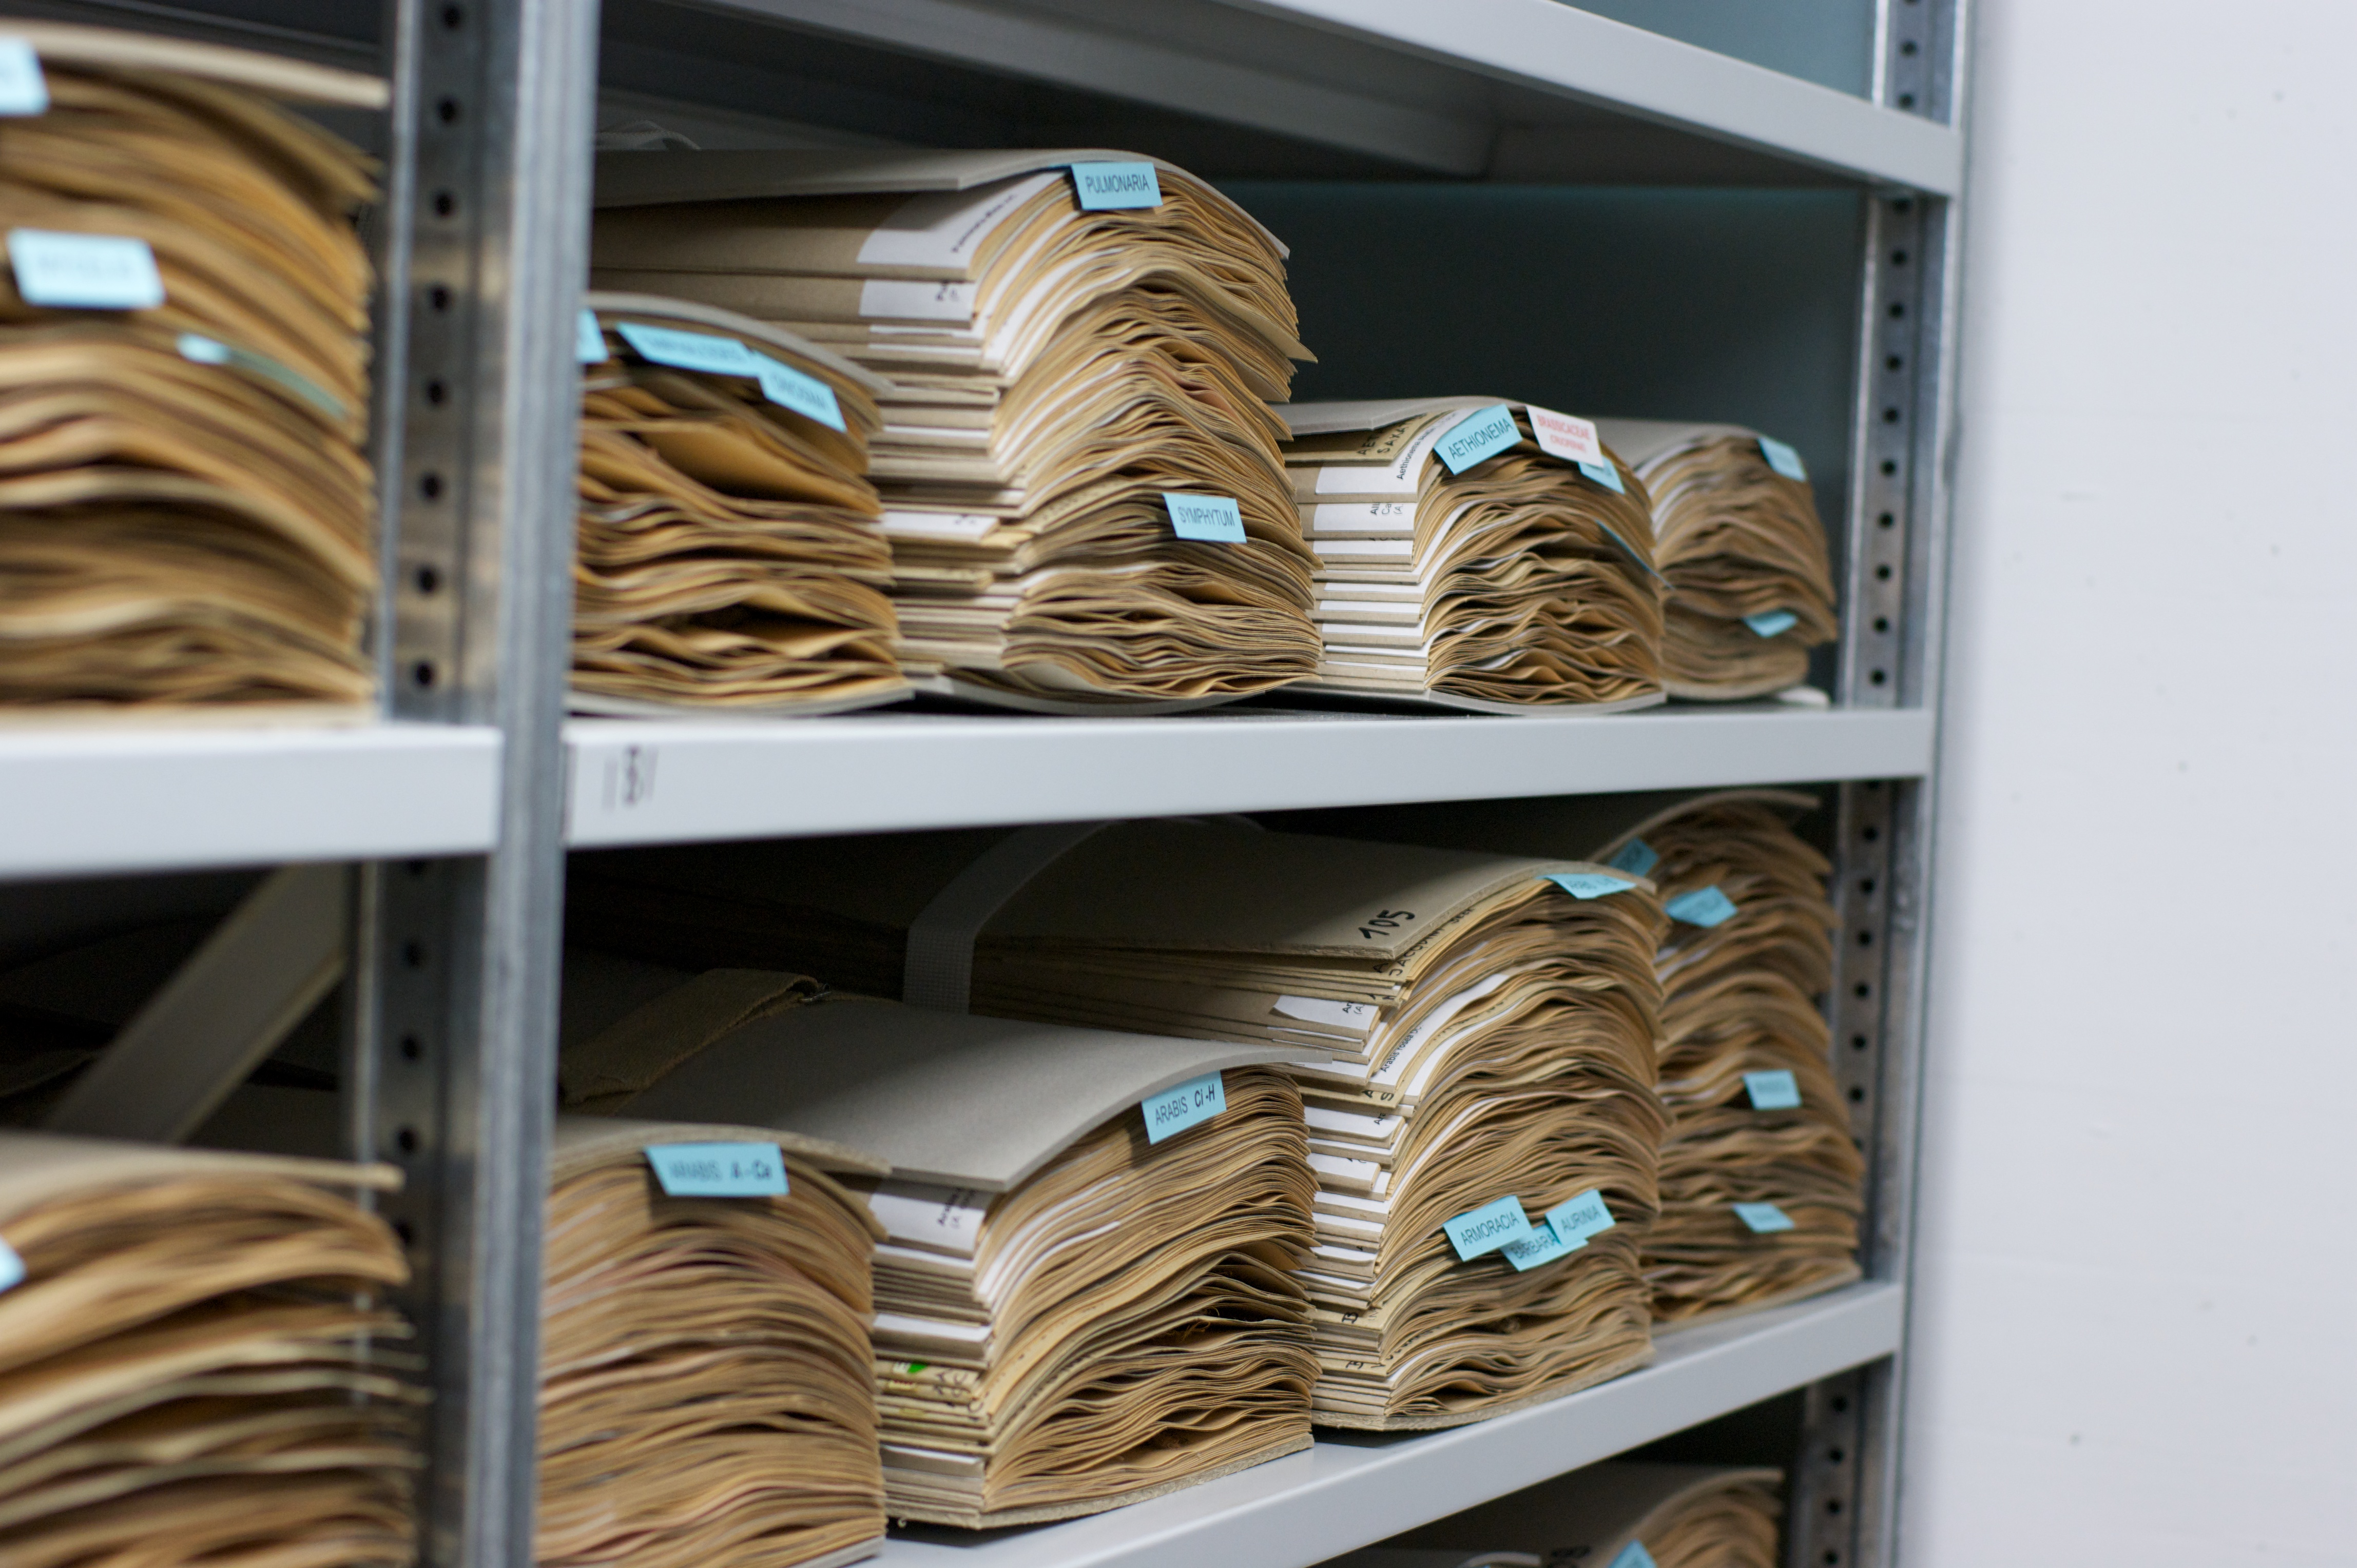
Current System: 1 sheet per section…
8580 sheets/year
86 lbs. or 5571 sq. ft.

Slide 3


Demo:

Slide 4
Our solution:
Coordinate between employees and supervisors
Replace inefficient, error-prone paper logs
Straightforward, personalized checklist interface
Separate pages for employees and supervisors
Update in real time

Slide 5
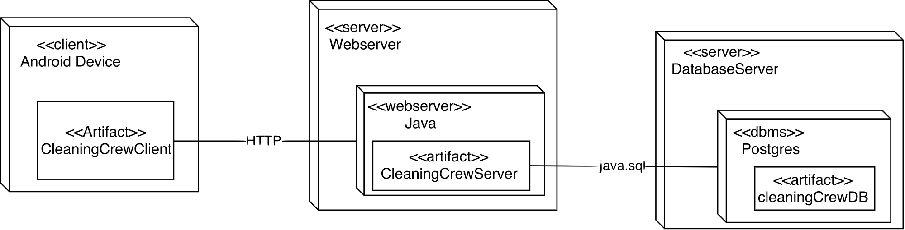
Deployment Diagram:

Slide 6
Server Schema:
User (ID, name, email, PhoneNumber, role)
Task (ID, AssignmentID, Description, isComplete)
Assignment (ID, RoomID, UserID, Comment, CompleteTime)
Room (ID, BuildingID, RoomNumber)
Building (ID, Name, Shorthand)

Slide 7
User Test Changes:
Move up login button
“Submit” settings changes
Case in-sensitive search

Slide 8
Self-Assessment:
What we got done:
Checklist of employee tasks
Supervisor/employee separation
Searchable employees
Commenting
Connect to server
What we missed:
See schedule
Request time off
See past cleaning

Slide 9
Make the world a better place
by making the world a cleaning place
with a
paper-saving,
efficient,
simple
way to coordinate between
employers and employees

Slide 10
Q A?

